Slide 1

Distributed Systems Lab 1 Focus: Corner Cases
ERMIRA Abdullahu
Junaid Abbas mohammed

Slide 2
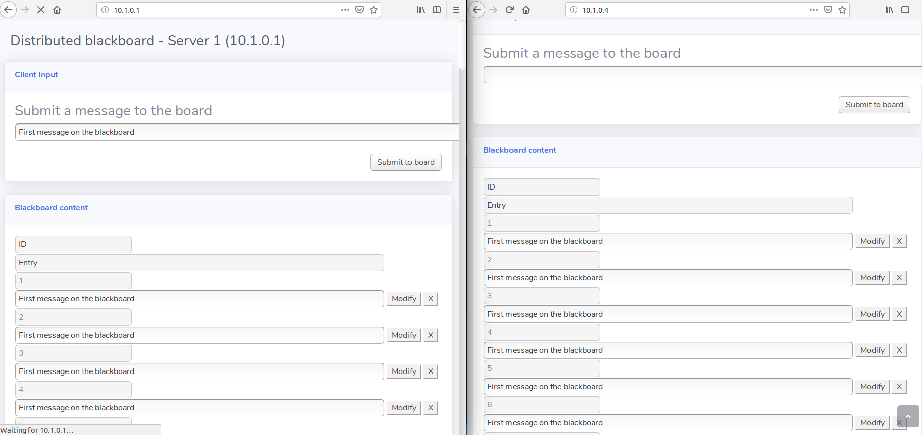
Corner Case: Adding new value
When Adding new values simultaneously it goes into loop

Slide 3
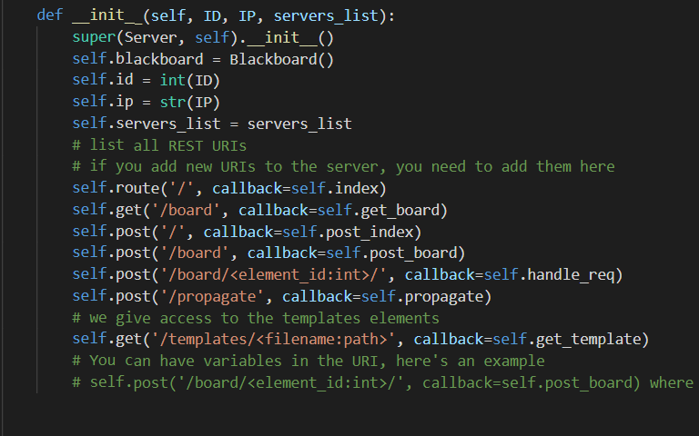
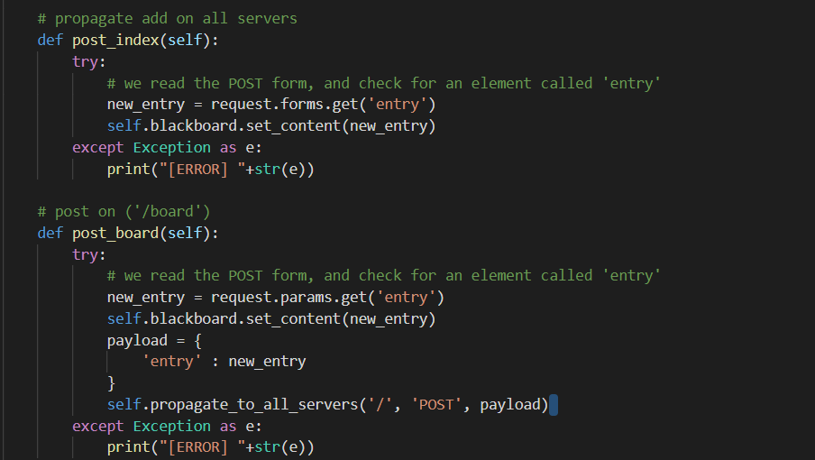
Corner Case: Adding new value (FIX)
Every operation (add, modify and delete) needs another route to propagate the data

Slide 4
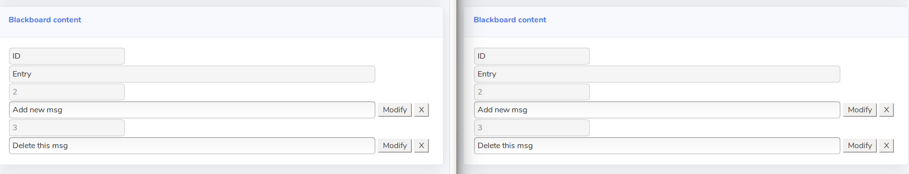
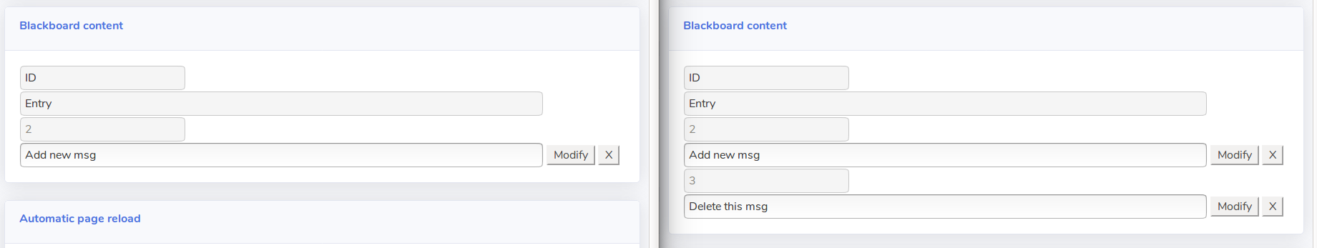
Corner Case: Deleting/Modifying simultaneously
The modifying/deleting operation on initial value will be replaced by the second modifying operation. Steps to generate the bug:
Add new messages and open second browser window
Delete one message from one browser window

Slide 5
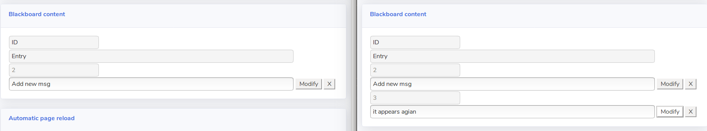
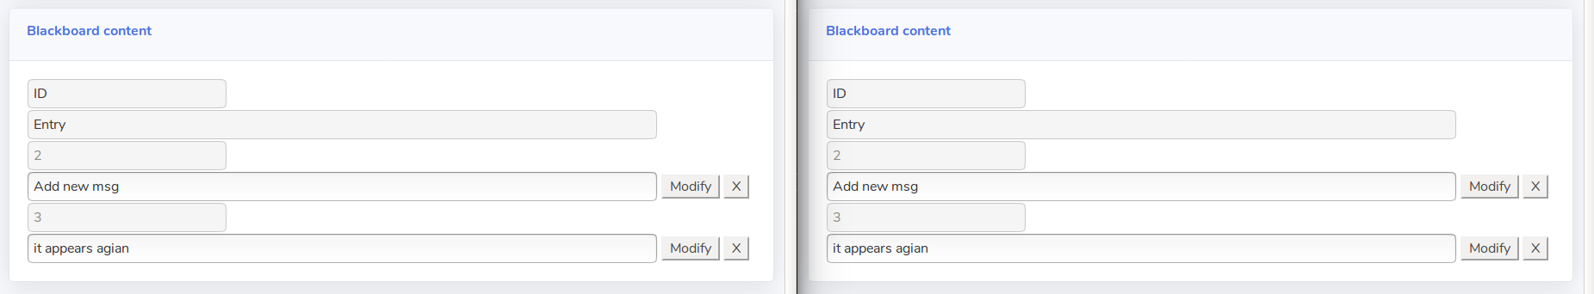
Corner Case: Modifying same value 2 times
Modify the same deleted message (before board gets updated) on other server
Click modify and the message appears in all servers

